Slide 1

Data Driven Fault Detection of VLSI Circuit
Vedika Saravanan
Nikita Acharya
Saurav Pradhan

Slide 2
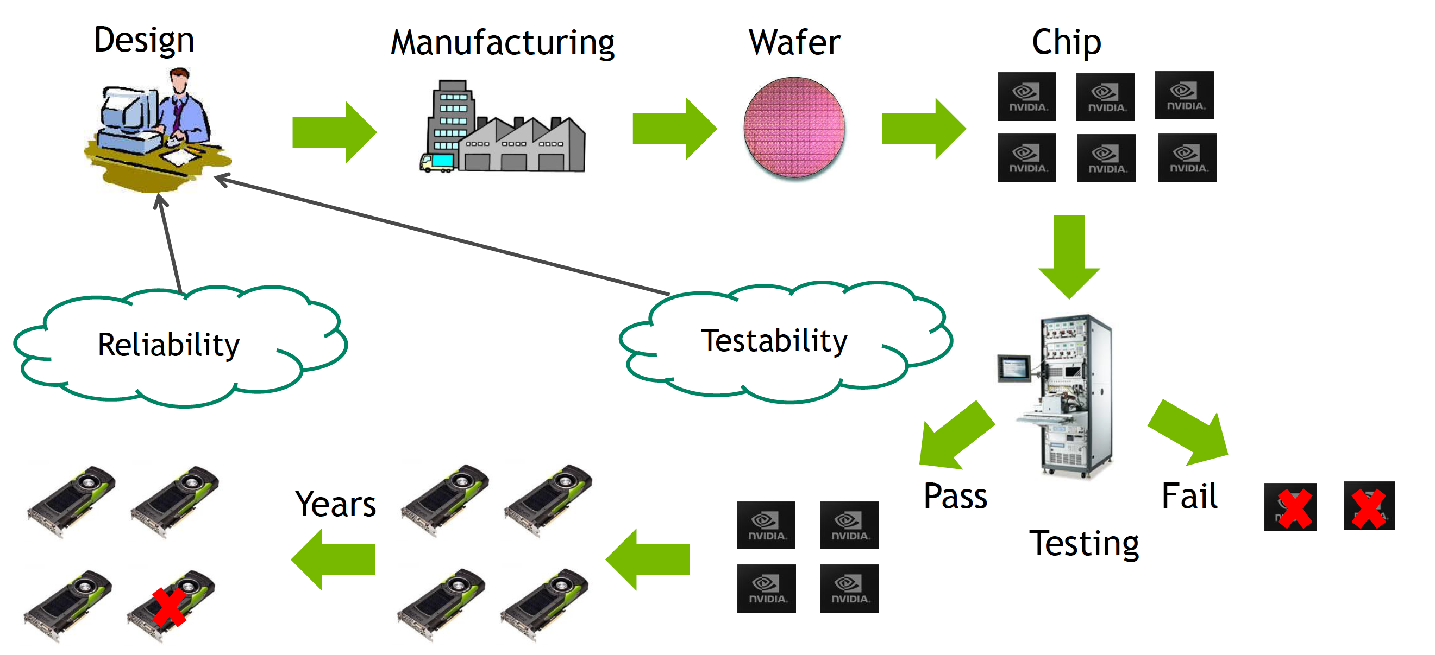
VLSI TESTABILITY AND RELIABILITY

Slide 3
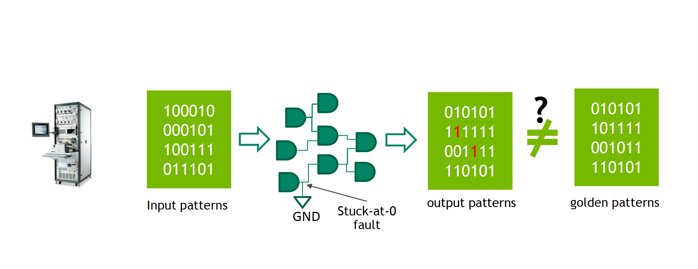
HOW DO WE TEST A CHIP

Slide 4
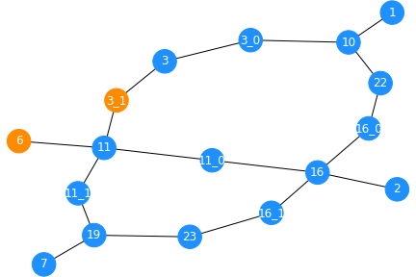
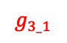
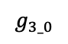
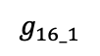

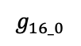
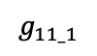
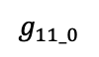
TESTABILITY PROBLEM
Easy to observe
Hard to observe
$C_{17}$VLSI Circuit
G10
G22
G1
$$g_{3_1}$$
G16
$$g_{16_0}$$
G2
$$g_{11_0}$$
G11
G23
G3
G19
$$g_{3_0}$$
$$g_{16_1}$$
G6
$$g_{11_1}$$
G7

Slide 5
MOTIVATION
Test Point Insertion Problem:
Number of test points → chip area cost
Number of test patterns → test time
Hard problem, only approximate solutions exist
Commercial solution: Synopsys TetraMax
Can we improve it with Deep Learning?
Predict testability

Slide 6
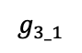
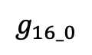
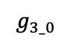
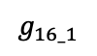
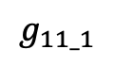

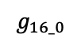
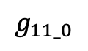
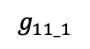
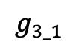
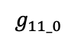
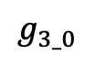
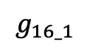
FEATURES : Logic Level, Controllability, and Observability
G1
G2
G3
G6
G7
Level 0
$C_{17}$VLSI Circuit
G10
G22
G1
$$g_{3_0}$$
$$g_{3_1}$$
Level 1
$$g_{3_1}$$
G16
$$g_{16_0}$$
G2
$$g_{11_0}$$
G10
G11
G11
G23
G3
G19
.
.
.
.
.
$$g_{3_0}$$
$$g_{16_1}$$
Features:
Logic Level: 4
Controllability-0: 4
Controllability-1: 2
Observability : 3
G6
$$g_{11_1}$$
G7
$$g_{11_0}$$
$$g_{11_1}$$
SCOAP testability measures:
Controllability: From 1 (easiest) to infinity (hardest).
Observability: From 0 (easiest) to infinity (hardest).
G16
G19
$$g_{16_0}$$
$$g_{16_1}$$
Level 6
G22
G23

Slide 7
BENCHMARK CIRCUITS
ISCAS ’85:
c1, c5, c17, c432, c499, c880, c1355, c1908, c2670, c3540, c5315, c6288, c7552
The EPFL Combinational Benchmark Suite:
Adder, arbiter, cavlc, ctrl, dec, i2c, int2float, max, multiplier, priority, router, sin, voter
Total dataset = 240587 nodes

Slide 8
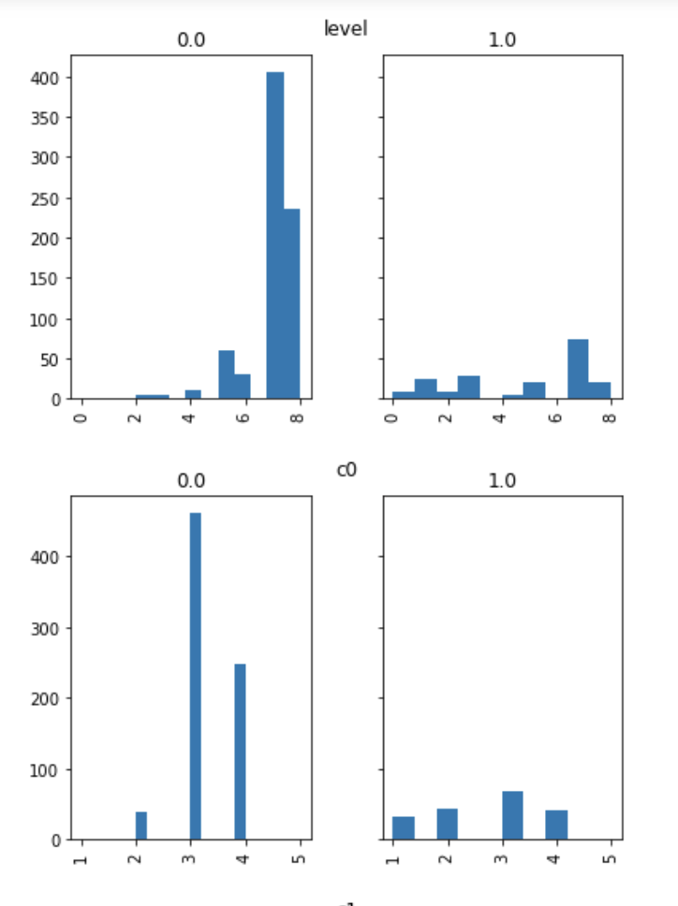
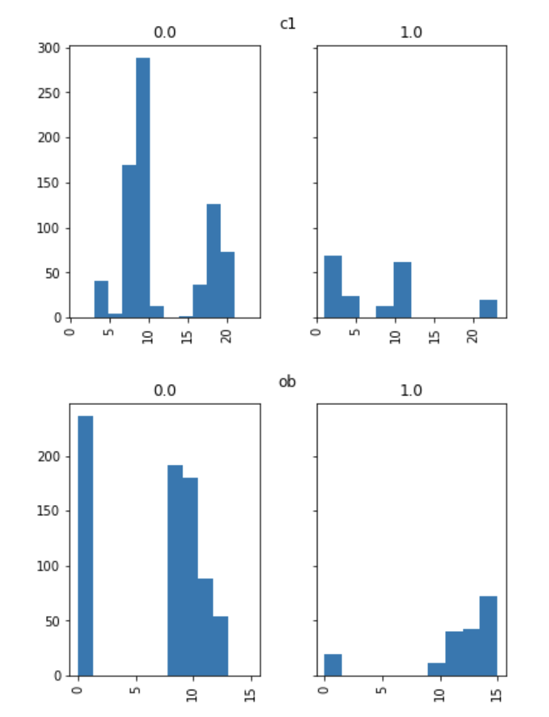
RAW INPUT DISTRIBUTION

Slide 9
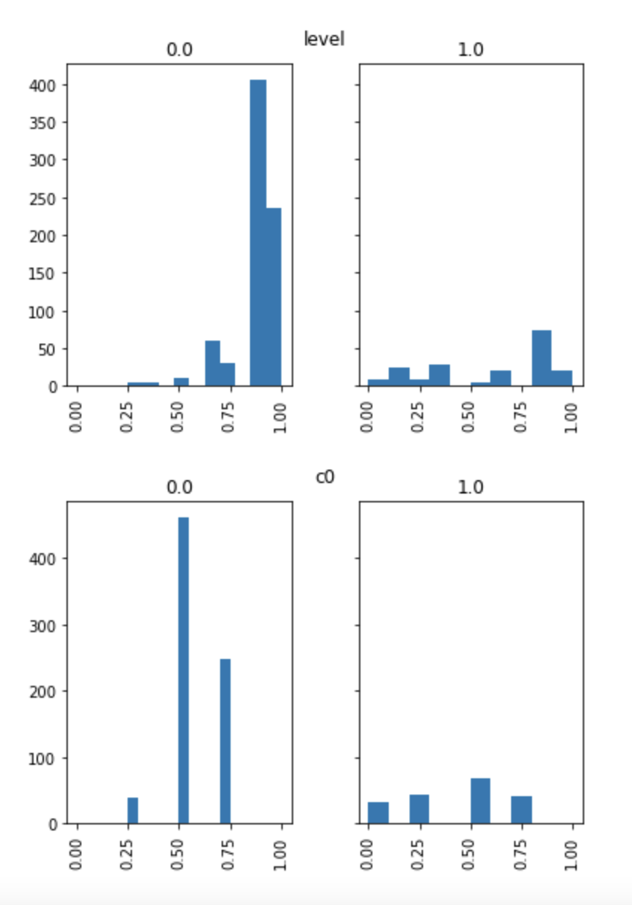
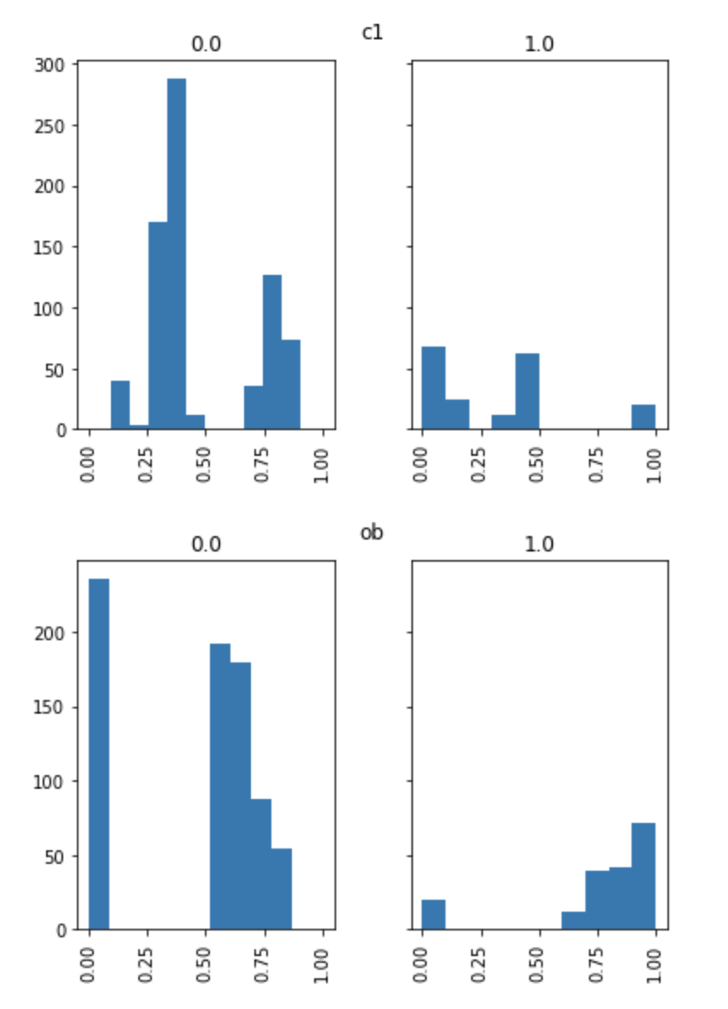
PREPROCESSED INPUT DISTRIBUTION

Slide 10
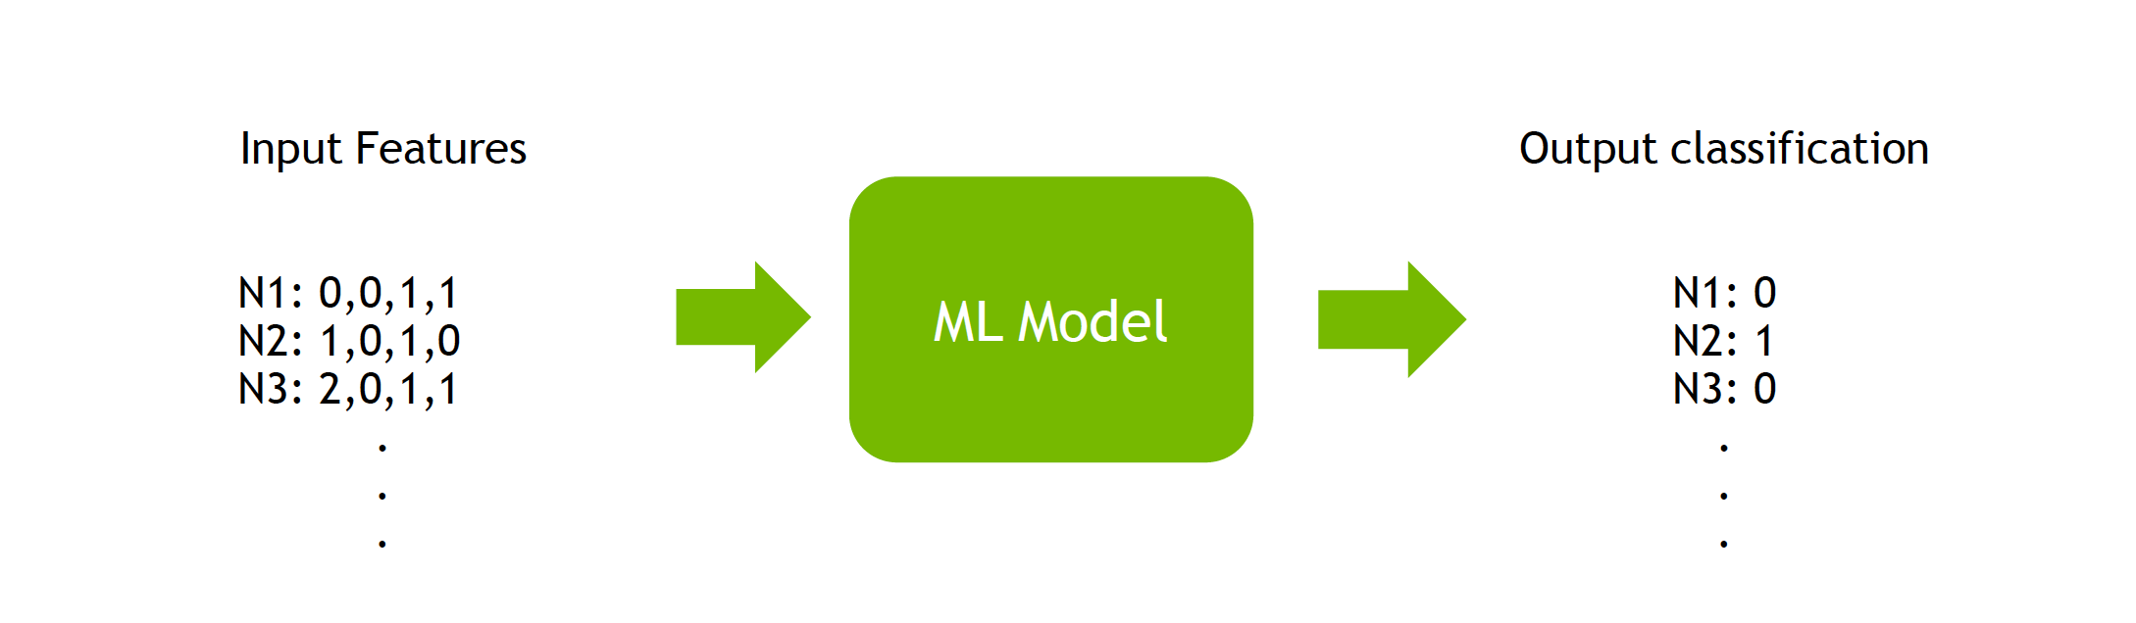
BASE-MODEL TESTABILITY PREDICTION
Given a circuit, predict which gate outputs are difficult-to-test (DT)
Gate Features: [logic level, SCOAP_C0, SCOAP_C1, SCOAP_OB]
Gate Label: DT (0 or 1) generated by tool
Decision-Tree Classifier

Slide 11
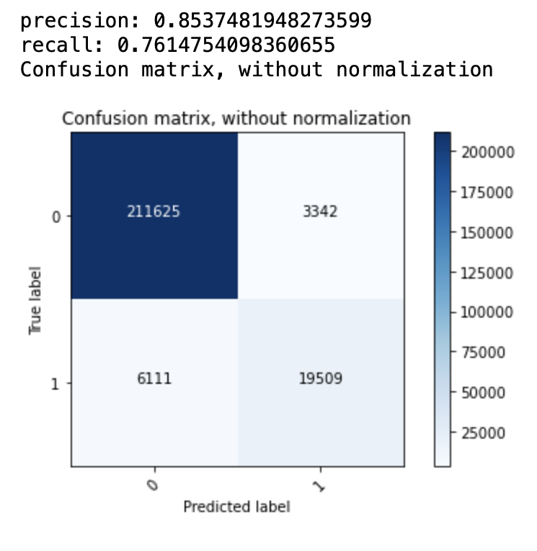
BASE-MODEL METRICS

Slide 12
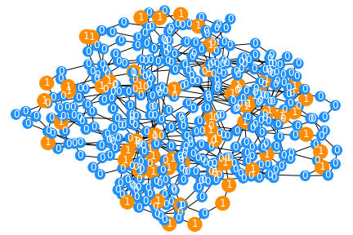
GCN – Graph Convolution Network
EO – Easy to Observe
HO – Hard to Observe
Nodes
Nodes
Nodes
Nodes
Nodes
Nodes
Nodes
Classifier
0 (EO)
1(HO)
ReLu
dropout
ReLu
dropout
ReLu
dropout
Sigmoid
Graph Convolution
Graph Convolution
Graph Convolution

Slide 13
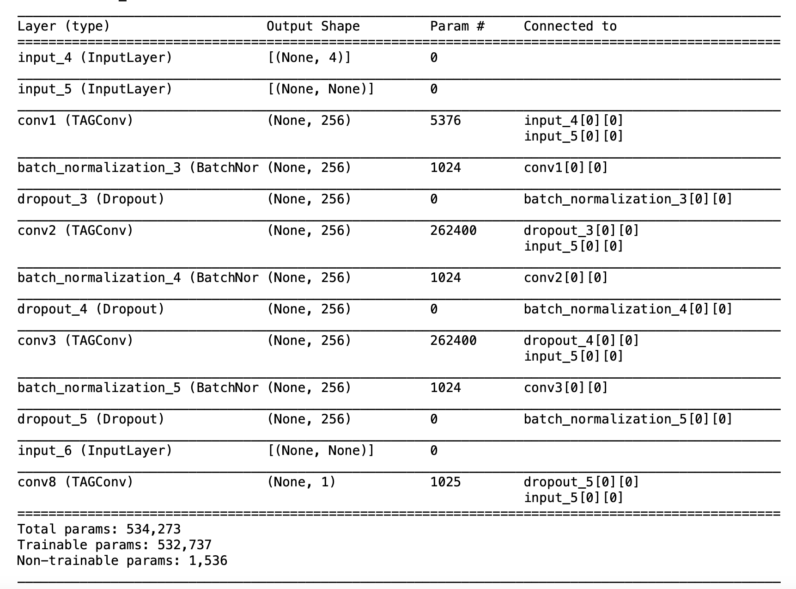
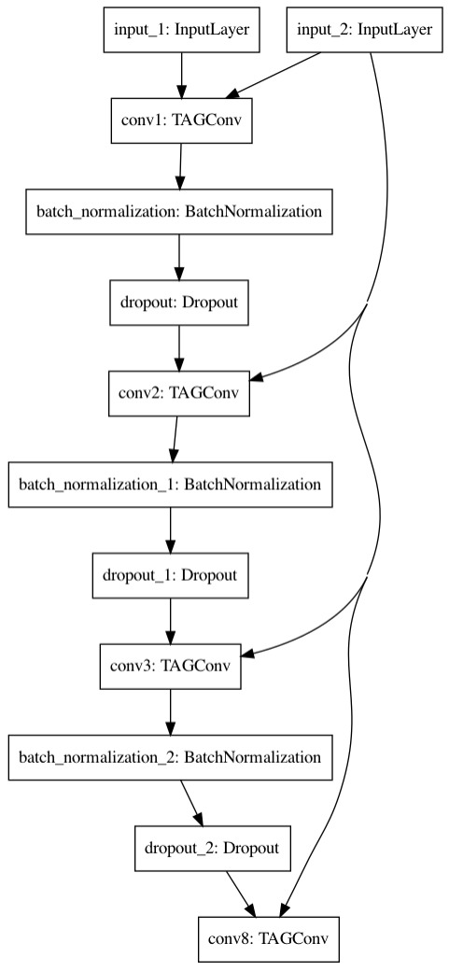
TAGConv MODEL SUMMARY AND PLOT

Slide 14
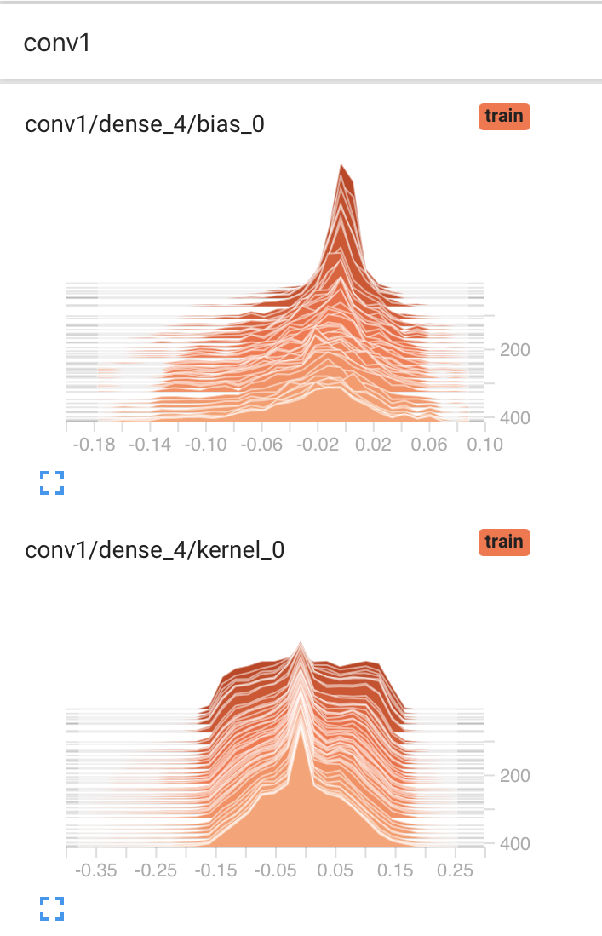
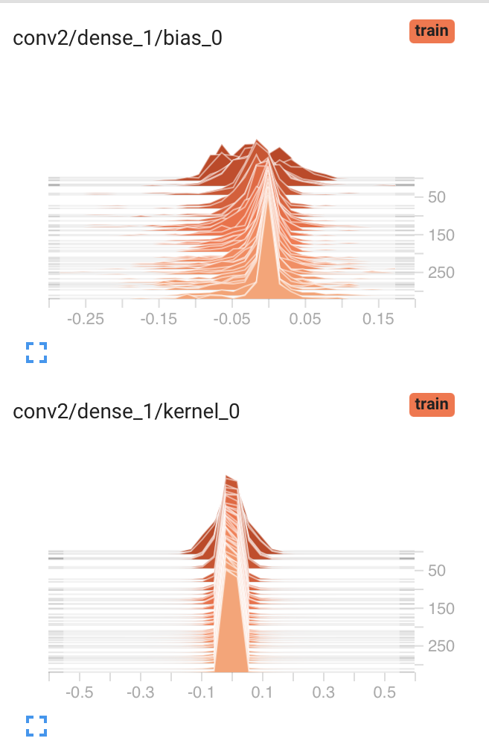
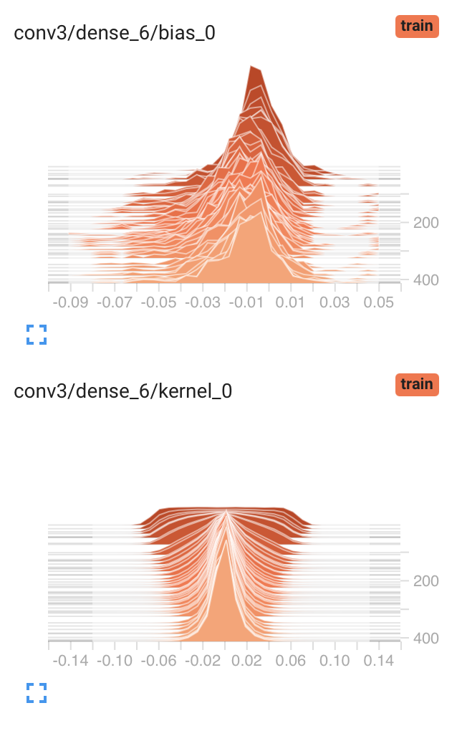
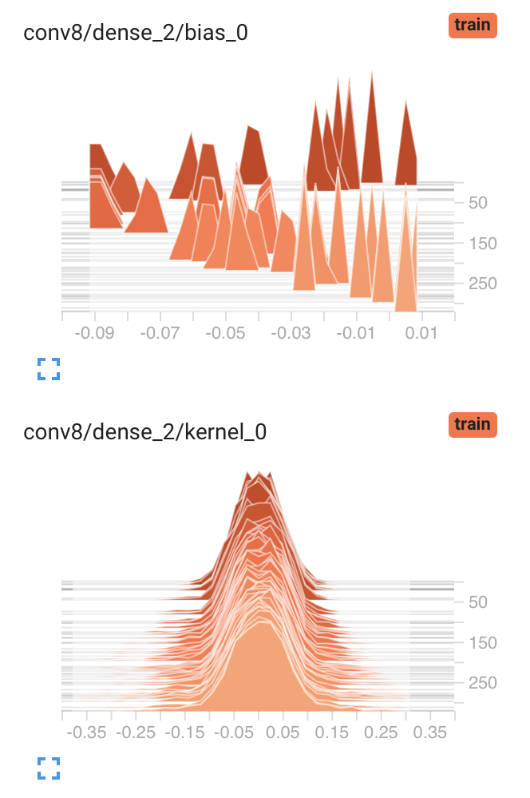
MODEL LAYERS HISTOGRAM

Slide 15
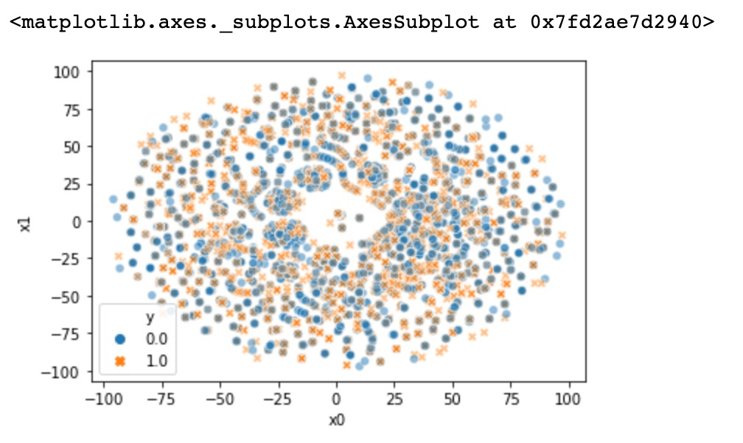
INPUT DISTRIBUTION FOR TRAINING DATASET

Slide 16
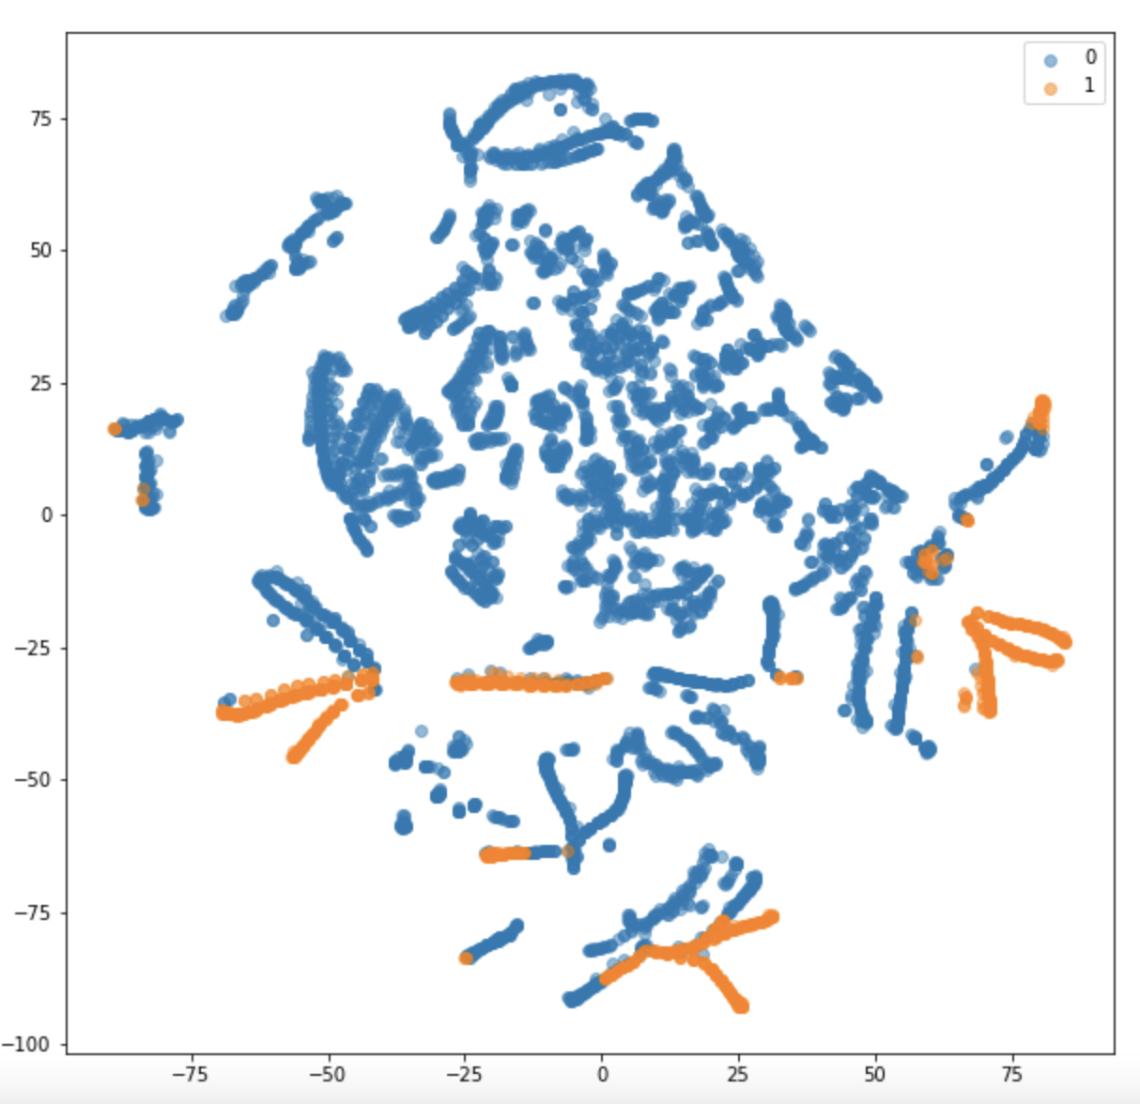
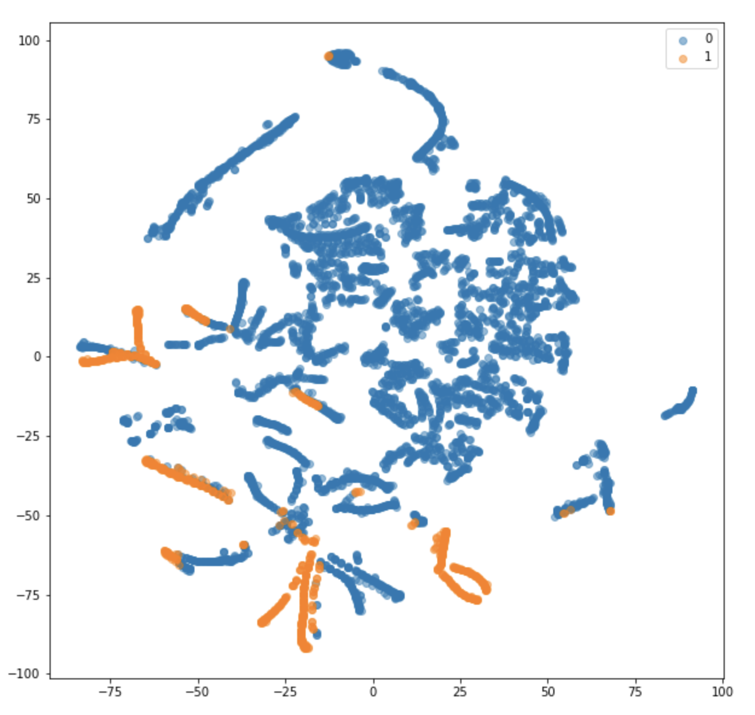
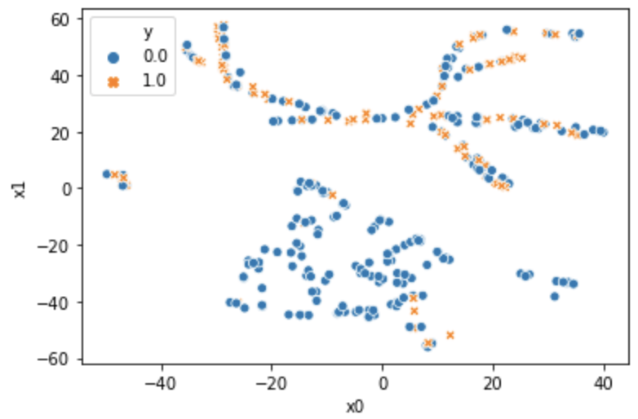
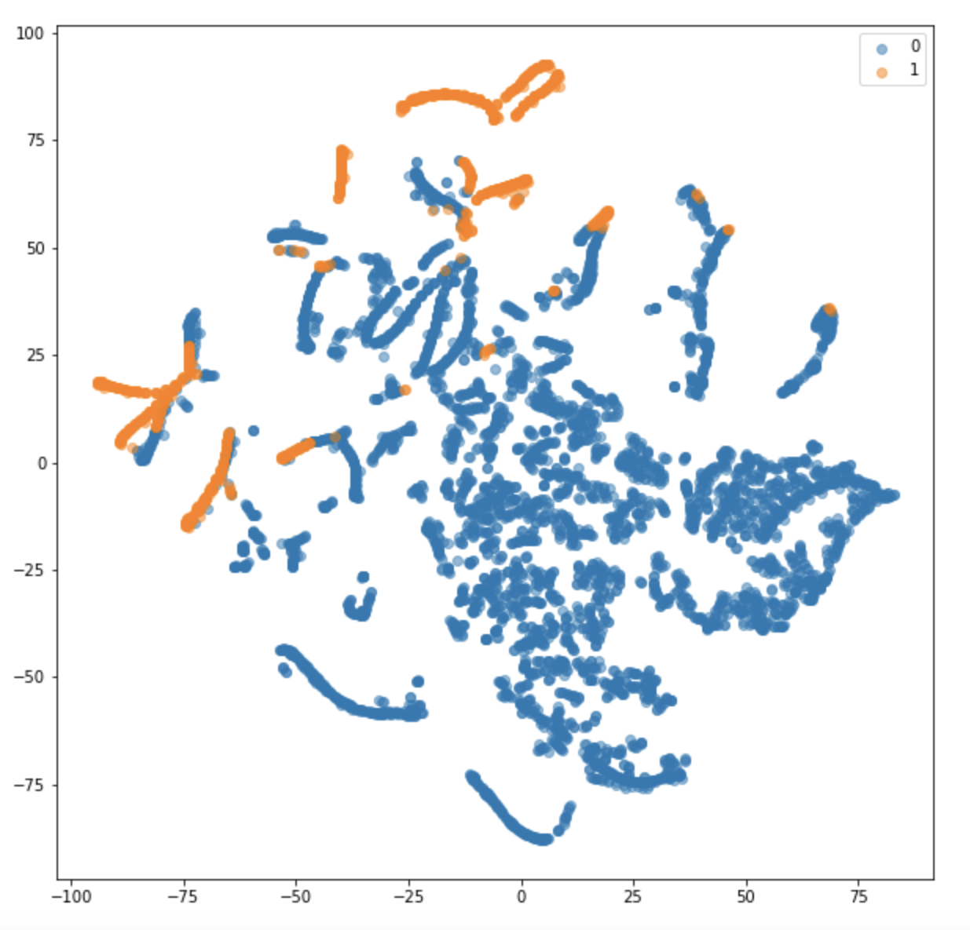
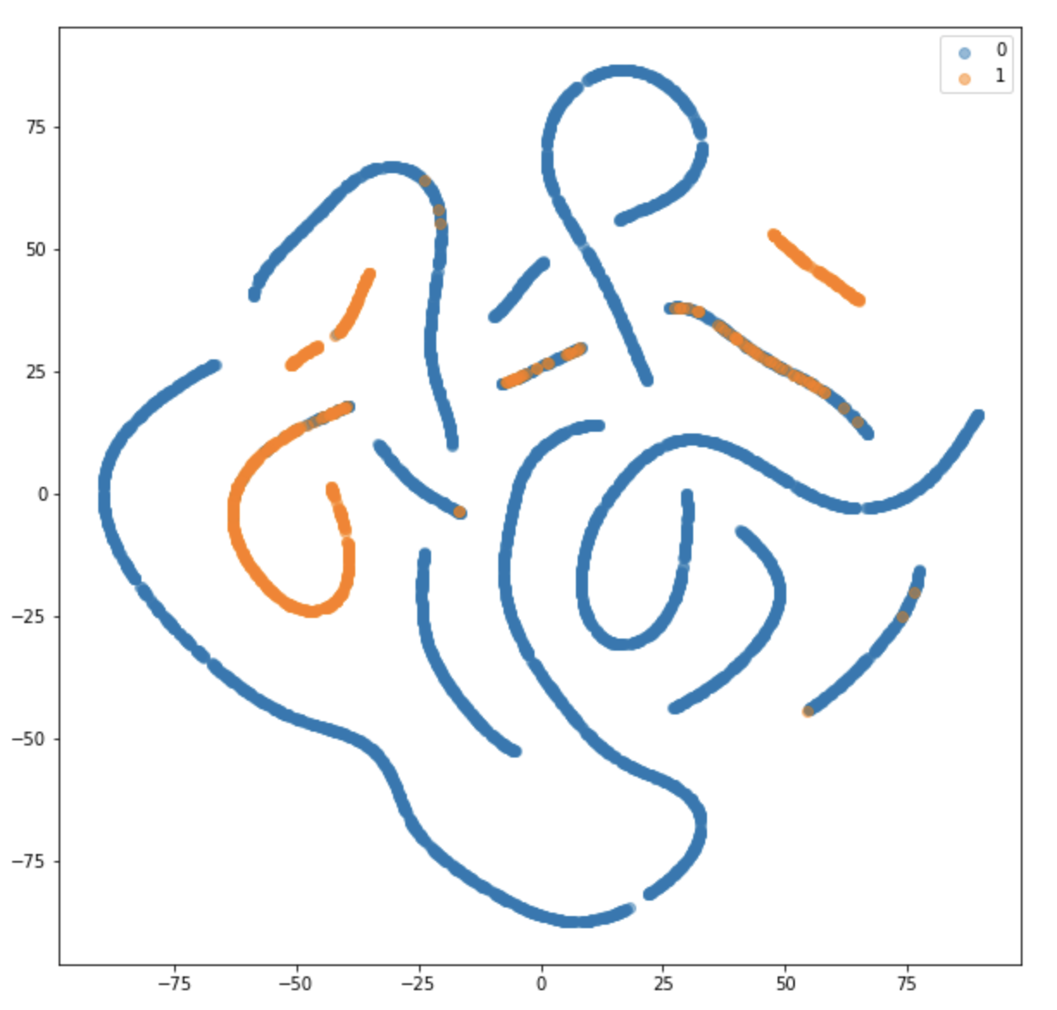
MODEL LAYERS OUTCOME
GCN
1
2
3
4

Slide 17
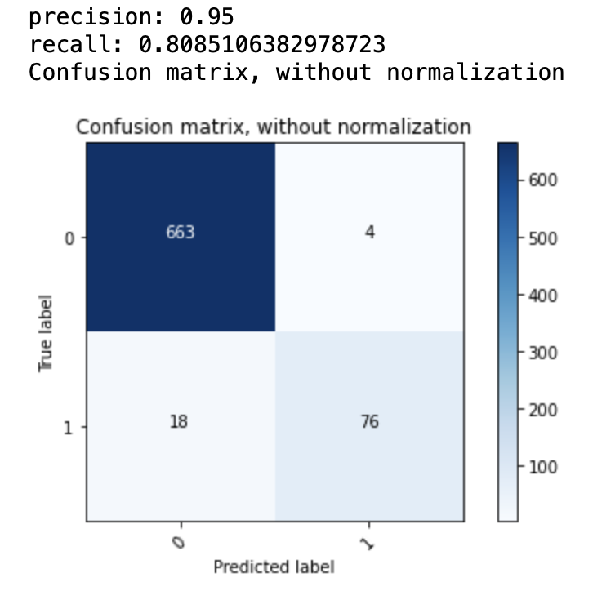
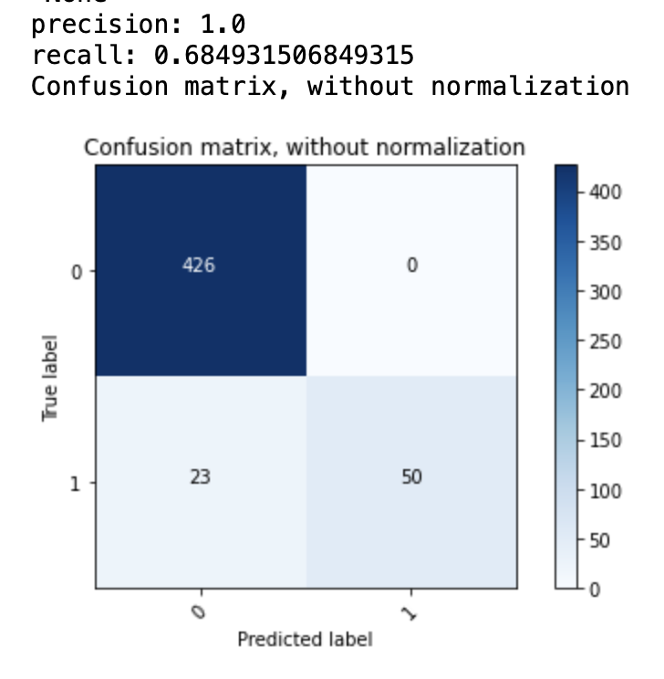
MODEL METRICS – CONFUSION MATRIX

Slide 18
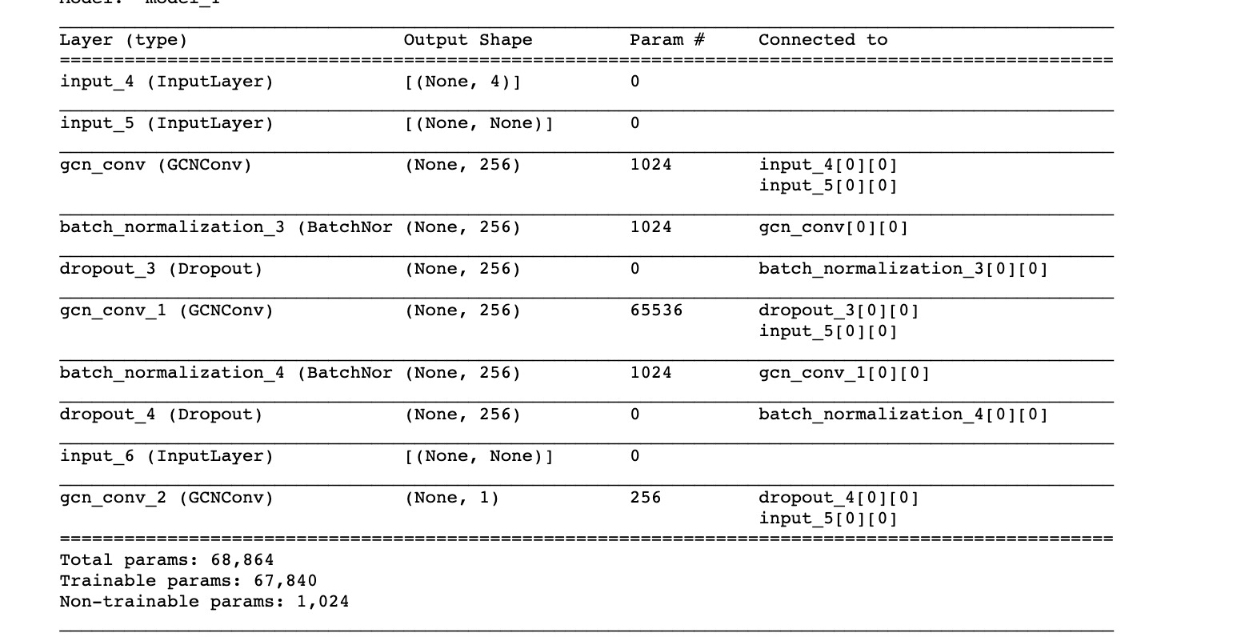
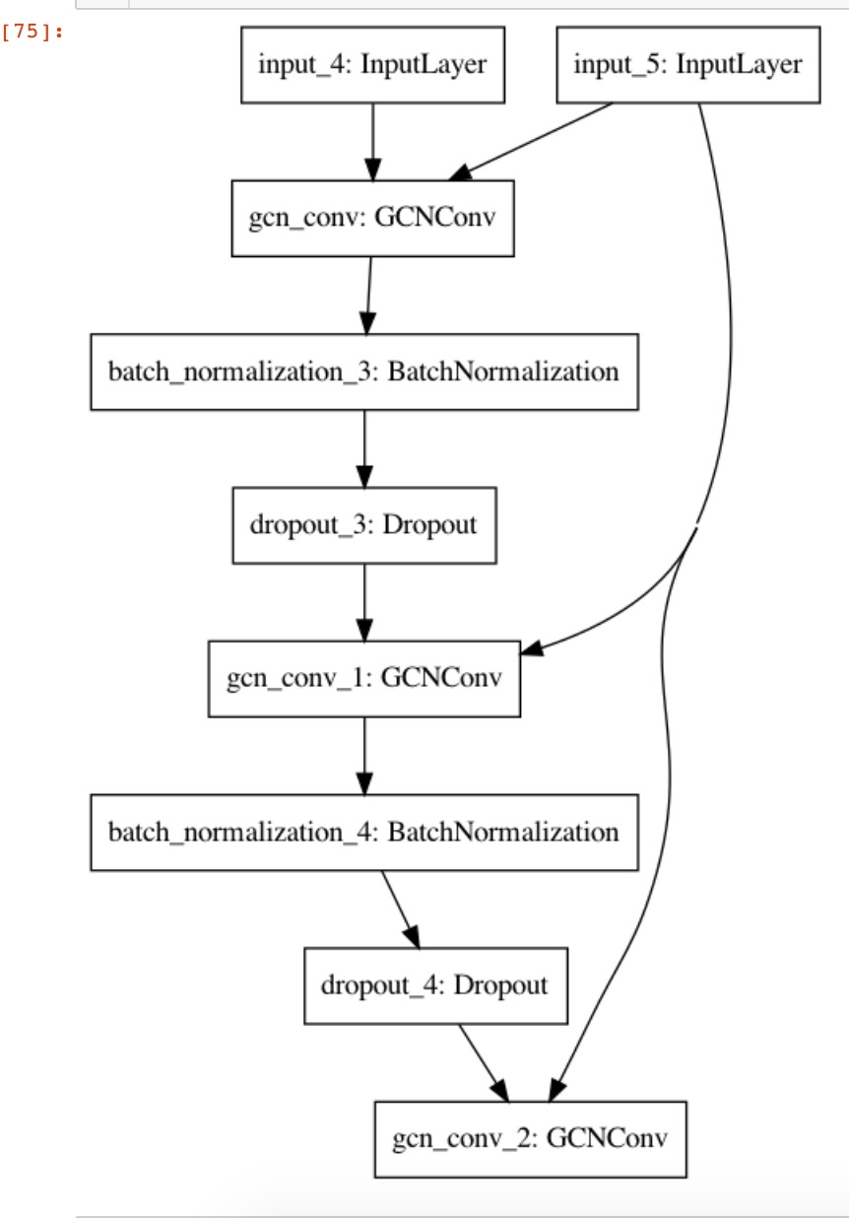
GCN MODEL SUMMARY AND PLOT

Slide 19
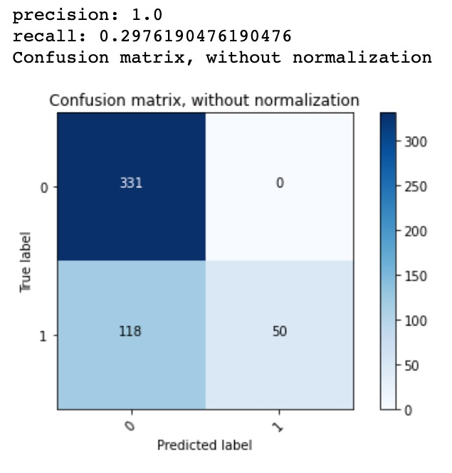
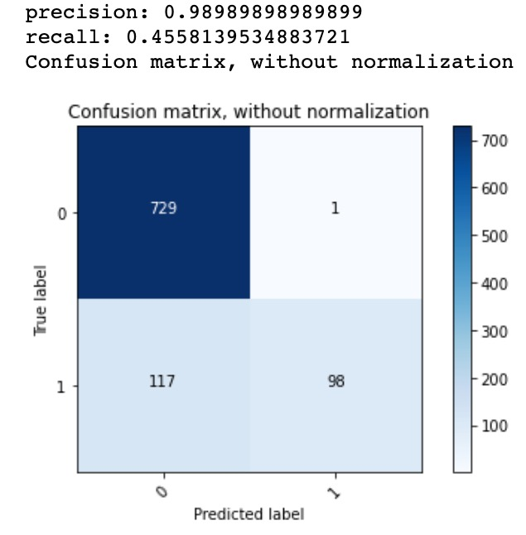
GCN MODEL METRICS – CONFUSION MATRIX

Slide 20
MILESTONES ACHIEVED
Input Preprocessing
Circuit level Min Max normalization of the features
Combined all the circuits to a data ( node features, adjacency matrix, and node labels) as a one big union of disjoint graphs.
Test, train, and validation dataset
Different model architectures

Slide 21
TACKLE UNBALANCED DATASET
Custom loss function.
Focal loss function.
Manual assignment of class weight.
Sklearn - compute_class_weight

Slide 22
SUMMARY
After trying out multiple architectures and different approaches for determining the class weights for the unbalanced dataset, the Topology Aware Graph Convolution (TAGConv) model.

Slide 23
REFERENCE
Du, Jian, et al. "Topology adaptive graph convolutional networks." arXiv preprint arXiv:1710.10370 (2017)
Kipf, Thomas N., and Max Welling. "Semi-supervised classification with graph convolutional networks." arXiv preprint arXiv:1609.02907 (2016).
Defferrard, Michaël, Xavier Bresson, and Pierre Vandergheynst. "Convolutional neural networks on graphs with fast localized spectral filtering." arXiv preprint arXiv:1606.09375 (2016).

Slide 24


THANK YOU

